Slide 1









Functional Programming with Haskell

Slide 2
Functional Programming with Haskell
Quinn Wilson / qwilson@obsglobal.com / @quinnwilson

Slide 3
Agenda
Why this presentation?
What is Functional Programming?
Why Functional Programming?
Why Haskell?
What’s next?

Slide 4
How I got here
shell script
perl
FoxPro
PHP
Java
VB
C#
Javascript
Ruby
F#
Haskell
Notes:
A little bit about me - I’ve been a programmer for twenty years
I’ve become proficient with a bunch of different programming languages.
I’m a dedicated learner – I make a deliberate effort to improve my skills and keep my tools sharp.
I love developing software.
I want to try all the tools, learn all the languages – I want to know everything – and I want to make awesome stuff

Slide 5
Why this presentation? (Why another functional talk)
I didn’t get why it mattered
I didn’t see what problem it solved
All I saw was something different – something scary
There is no way that the following actually means something:
((.)$(.))
Notes:
I was first exposed to functional programming with F# - I saw a language that didn’t give me a way in – it didn’t look enough like C#, or C or any of the other languages that I had learned.
It was different and it looked hard and frankly just to add another language for the sake of having another language – the cost / benefit ratio was off.
It was only AFTER I started digging into Haskell that I really started to understand why functional programming matters.
And learning something new and scary is always a benefit in and of itself. I’m a better programmer as a result.

Slide 6
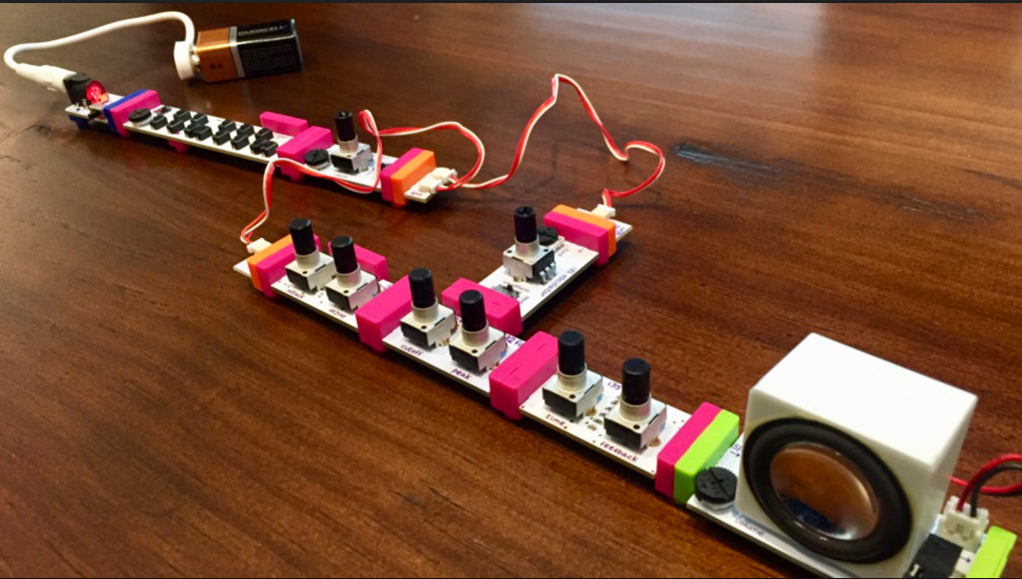
Notes:
These are called Little Bits – My son showed me these – he told me that you can take a bunch of these electronic building blocks and combine them in novel ways without any understanding of the inner workings of the components themselves – they have a common interface format and you can just mix and match them and compose new and interesting things. This was like a lightbulb moment for me – this is what we programmers should be building. Programmers need to be working towards building composable, reusable, and modular software like these little bits.

Slide 7
What is Functional Programming?

Slide 8
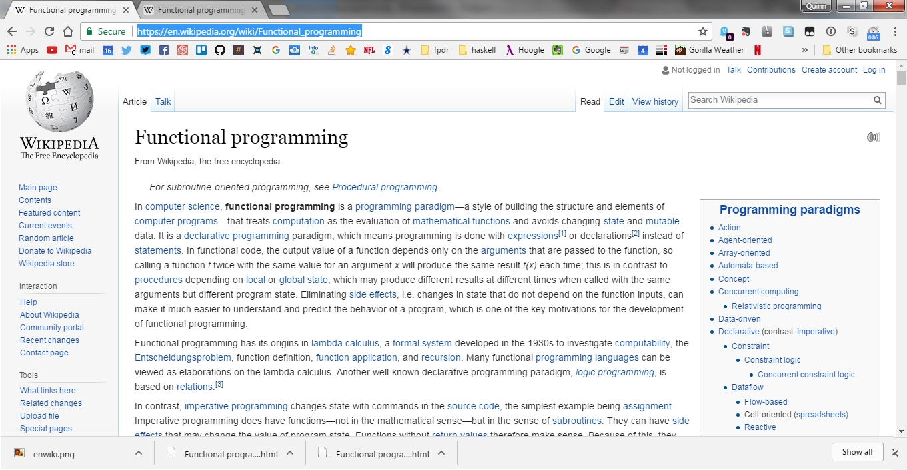
Notes:
Wikipedia has a very concise explanation of Functional Programming – but it contains a bunch of terminology like:
Lamda Calculus
Formal System
Category theory

Slide 9
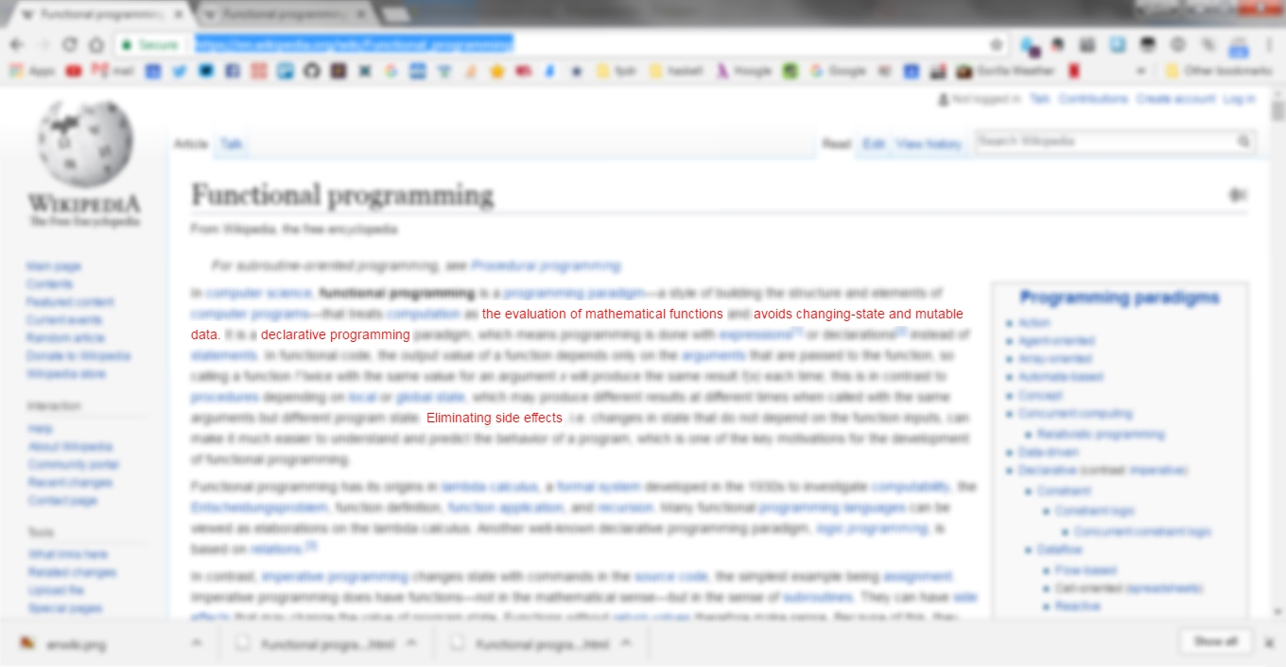

Slide 10
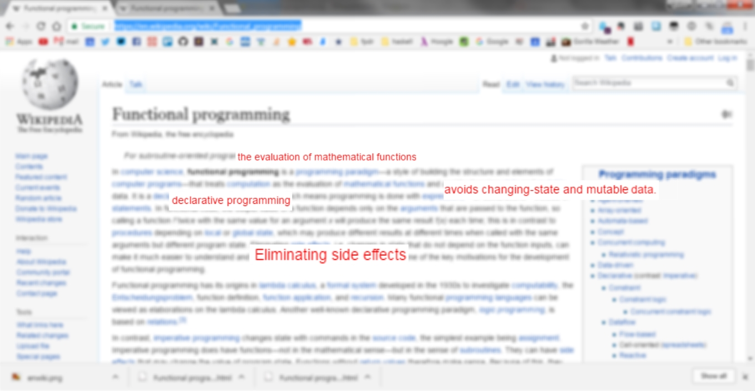

Slide 11
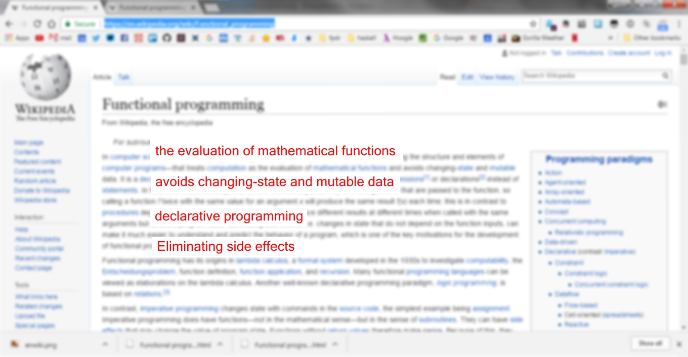

Slide 12
1. Eliminating Reducing side effects
ONE of the key motivations of Functional Programming
side effects are observable changes in state outside of the current scope
Notes:
side effects are what makes imperative programming difficult
side effect are one of the key reasons we don't have the LEGO component driven development that software vendors have been promising us for as long as there have been software vendors
The more we change things outside of our current scope, the more we’re merging the two scopes
The more we do this the more burden on the programmer in reasoning about what interactions will occur
side effects are not the only kind of bug we make - but they are often not failures in our logical reasoning and they're not "mistakes" they are an unintended consequence of interactions
(what if we could prevent those interactions?)

Slide 13
2. The evaluation of mathematical functions
functions in Functional Programming are analogs to functions in mathematics
They are
Idempotent ƒ(ƒ(x)) ≡ ƒ(x).
referentially transparent f(x) = f(x)
"Pure" (deterministic) functions with no side effects can be proven mathematically.
Notes:
Idempotent – can be applied multiple times without changing the result beyond the initial application (i.e. abs(abs(x)) ≡ abs(x) )
A referentially transparent expression can be replaced with it’s corresponding value without changing the programs behavior i.e
string getFileName() = “file1.txt”

Slide 14
2. The evaluation of mathematical functions
When our functions behave like mathematical functions we can use them as basic units of abstraction.
We then gain a systematic and proven approach to composing larger parts of smaller parts, that works on every level, at every scale.
Notes:
Using functions that resemble mathematical functions is a design decision not an outcome or effect of Functional Programming
If we ensure that the result of a function doesn’t vary according to anything that isn’t supplied as a parameter
Doesn’t alter any of the parameters that were supplied
Doesn’t alter anything outside its scope,
And thus the result should always be the same for the same supplied parameters
We are able use pure functions as basic units of abstraction – we are able to use a good deal of collective knowledge we’ve obtained from the field of mathematics about the properties of functions.

Slide 15
3. Avoids changing-state and mutable data
Once a “variable” is set it cannot change
key constraint to reduce complexity and side effects
key stumbling point for traditionally imperative programmers
Notes:
Avoiding changing state and/or mutating data is a DESIGN DECISION not an EFFECT of functional programming.
traditionally imperative programs contain variables that are actually references to memory locations which can be modified, so when you pass around a variable you need to understand the context of it's usage - this is where the complexity is introduced
A note on my talk – I’m going to probably call a Haskell constant a variable – I’m programmed to call something I assign a value to a variable. Tsk

Slide 16
4. Declarative programming
the programmer expresses the logic or intent of a computation without expressing the steps to achieve it
another key constraint of functional programming
Notes:
Another design decision
Examples from the imperative world include Linq (.net), Bulk Data operations (java), List comprehensions (python, ruby), TSQL

Slide 17
Why Functional Programming?

Slide 18
The problem – mutability and “effectful” code
Understanding and debugging a function with side effects requires knowledge about the context and its possible histories [1]
As a system grows, the knowledge and context required to understand the system grows
Pure functions do not require this context
Notes:
The effects of a pure function are in the type signature.

Slide 19
The problem – mutability and “effectful” code
Global mutable state creates interdependencies between all parts of the code, and programming languages provide no means for expressing these explicitly.[1]
Mutable state is why we can’t have nice things
Notes:
Mutable state is why we don’t have the Lego building blocks we were promised – It’s verrrry difficult to build reusable code that has side effect because you have to manage and account for those side effects – if it has global mutable state and you want to reuse it you need to manage that global mutable state in new places.
From global variables to locals – the greater the scope the greater the interdependency you create.
The tendency when refactoring is to move mutable variables outward into larger scope
*with OO programming you’re constantly fighting against the paradigm* maybe I’m disillusioned, but the OO design patterns are a failure like “telling people to eat right and exercise is a failure. It’s not wrong it’s just not getting done“
We need to figure out a way to make a computer manage it so a human doesn’t have to.

Slide 20
Object-oriented programming is a poor attempt at the modularization of the assembly line. Not only because, in doing so, it introduces somewhat arbitrary-feeling means of composition, like members and inheritance. But mainly because all that encapsulation achieves is the breakdown of the global mutable state into smaller pieces, which then get hidden inside modules called classes. But it doesn’t really change the fundamental paradigm of the assembly line, and address the underlying problem of interdependencies. It covers up (encapsulates) larger sections of the assembly line, but those sections can rarely be rearranged in unanticipated ways. And even if so, there is no systematic and proven way of doing it (unless we consider GoF design patterns as such).
https://hackernoon.com/why-functional-programming-matters-c647f56a7691
Notes:
I’m not going to read this whole slide to you – but this is the best explanation I found for what FP solves
It gets to the heart of why I feel that OO programming is broken at it’s core – and when I say that I don’t mean to suggest it’s no good for anything –
I work in it all day every day – I’ve built large systems with OO programming – it drives the world..
But I see the problems with it and I think Functional Programming is the solution.

Slide 21
Motivation
Reduce complexity
Modularity
Composability
Code reusability
----------------------------------------
Code that does not resist change
Notes:
Through the use of language design decisions we can reduce complexity by reducing the contextual load on the programmer
Mathematical functions allow for black-box reuse of code
Those functions can be used as building blocks to compose larger programs
Code without side effects is very reusable
Putting it all together you get code that is very malleable.
How many times have you (I) been in a situation that you have had to make radical changes to a system to accomplish something that seems like a very small change.
By it’s nature functional programs are resistant to this kind of problem - nothing is immune to bad design

Slide 22
Higher Order Functions
Functions which accept other functions as arguments or return functions as results.
Higher Order Functions are a the key to building general patterns.
Notes:
The ability to easily compose functions encourages factoring functions for maintainability and code reuse.
Developers embracing the FP design constraints combined those constraints to produce some interesting results.
What do I mean by the key to building general patterns? When we see patterns of behavior over and over in the things we do we want to extract that “pattern” and make it reusable in a generic way – for example: we often want to sort things. Now I learned bubble sorts and quick sort and other algorithms in school and I could spend my time and implement that quick sort every time I need something sorted or I can use a general pattern. In C# I would just call .Sort() on something that implemented IComparable or I would write in a single equality function that would plug into the .Sort() function and that would be it.

Slide 23
Functional Programming Idioms
map
applies a function over a list and returns another list (normally transformed in some way)
sometimes called other by other names (transform is a common one) but usually has map in the name (with a notable exception of .net's Select)
filter
applies a function over a list and returns a list of items that satisfy the boolean requirements of the function
.net calls it Where
other names: some variant of findAll, or grep

Slide 24
Functional Programming Idioms
fold
applies a function over a list with a value that gets passed as argument, and returns a value of the same type
sometimes called reduce (though reduce and fold have some subtle but important differences )
.Net calls it Aggregate
Haskell has three functions foldl, foldl' and foldr that again have some subtle but important differences
maps and folds (and their variants) are among the most powerful tools in the toolbox
Notes:
Those are some of the heavy lifters of the functional world and you can use them to accomplish a surprising number of tasks, you can combine them, you can chain them or fuse them. The point is that when you use these functions you are declaring an intent in terms of pure functions without prescribing how to do that work.

Slide 25
Functional Programming Idioms
What you start to see as you solve problems with maps and folds is that most of what you want to do in software development is transform
a list of something into another (same sized) list of something = map
a list of something into a value = fold or reduce
a list of something into a smaller list of something = filter, take, or drop
…or some combination of two or more of the above
Notes:
Map and fold and filter and other higher order functions are the hallmarks of functional programming – they allow you to express a common operation over a list but do not define the HOW of how to do it.
Don’t use a for or a while loop, Loops are
What you start to see as you solve problems with maps and folds is that most of what you want to do in software development is transform
a list of something into another (same sized) list of something = map
a list of something into a value = fold
a list of something into a smaller list of something = take, drop, filter
or some combination of two or more of the above

Slide 26
Recursion
Functional Programming relies heavily on recursion to dispense with loops.
Without a loop - a construct that is grounded specifically in the how (to solve a problem), one must resort to recursion to get loop-like behavior.
Notes:
Recursion works very well in the constraints defined by Functional Programming
Many problems can be expressed naturally using recursion, once you understand it.

Slide 27
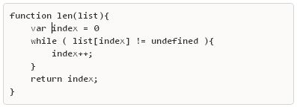
Imperative Loop

Slide 28
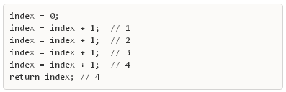
Imperative Loop

Slide 29
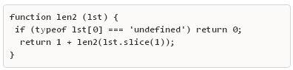
Recursion

Slide 30
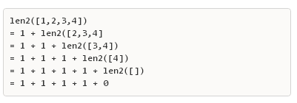
Recursion
Notes:
Since we know that our functions fit the description of the mathematical function we can see that each of these iterations is true and equal and that there is no mutation of data

Slide 31
Why Haskell?
Notes:
I learned FP with javascript – the much maligned javascript – I love javascript, I get lots done with javascript – at the same time it’s the poster child for global mutable state.

Slide 32
What makes Haskell different?
Functional
Lazy evaluation
No side effects (everything is pure, IO happens via monads)
Incredibly expressive static type system
Type inference

Slide 33
What makes Haskell different?
Functional
Lazy evaluation
No side effects (everything is pure, IO happens via monads)
Incredibly expressive static type system
Type inference

Slide 34
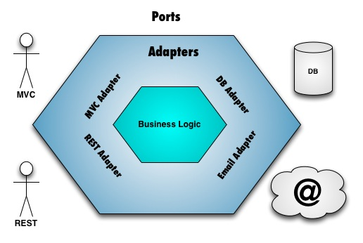
What makes Haskell different?
Notes:
The design of your program is heavily influenced by the design decisions of Haskell – you maximize the number of pure functions you write, pushing the impure code (by impure I mean side effects or IO code) to the edges of the system. A good Haskell program has a big core of pure functions, and a shell of IO code.
Essentially, Haskell's type system enforces the Ports and Adapters architecture. The ports are all your IO code, and the adapters are the monads you reach into the program with. The application's core is all your pure functions. The type system automatically creates a pit of success.

Slide 35
Get started
Get Haskell https://www.haskell.org/downloads
Download, install, play
“Hello World” in two lines:
Save to helloworld.hs, compile with
ghc helloworld.hs
Run helloworld
main :: IO ()
main = putStrLn "Hello World"
Notes:
I’m not just wasting our time compiling and running this code to prove to you that this example works
There are a couple of elements to look at in this example. The type signature of the function 1) not required 2) :: IO()

Slide 36
The Haskell Type System
Haskell is statically typed
Strong type system
Type inference
A function takes the general form
Name :: Return Type
Name :: Argument Type -> Return Type
This is critical to understanding how to read Haskell
:: is read as "has type of“
-> arrows indicates a flow or map from left to right
Notes:
Example ghci
In the first example Name :: Return Type you read it “Name has type of Return Type” and since we learned that a function can only vary by it’s arguments and nothing else – we can conclude that this function is….. ? A constant
In the second example Name :: Argument Type -> Return Type you read it ‘Name has type of Argument Type -> Return Type – meaning that it maps from Argument Type to Return Type
Example ghci let test = ‘abc’ , let test2 a = ‘abc’ ++ a
let add2 a b = a + b

Slide 37
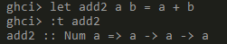
The Haskell Type System
=> indicates a “class constraint”
In the example above we can read it like this:
the add2 function takes any two values that are of the same type and returns a value of the same type . The type of those all three values must be a Num type (e.g. Int or Float )
Notes:
Example let add2 a b = a + b
let addToSeven a = add2 a 7

Slide 38
Primitive types
These are familiar from every other programming language
Int, Char, Double, Bool, Float
There are many, many built in types
Types are capitalized – that’s how Haskell knows it’s a type

Slide 39
example
Numbers
Math
Division
Boolean operations
Notes:
1 + 1 , 8 - 1 , 10 * 2
35 / 5 , 35 / 4 , 35 `div` 4 --
not True , not False
1 == 1 , 1 /= 1 , 1 < 10

Slide 40
Lists
Collection – stores zero or more elements of the same data type
E.g. evenNumbersToTen = [2,4,6,8,10]
Concatenate two lists with ++
Lists are the fundamental construct in Haskell
Common built-ins :
head, tail, last, init, take, drop, length, reverse, maximum, minimum, sum, product, elem, repeat, replicate
The List goes on..

Slide 41
Ranges
[1..10] = [1,2,3,4,5,6,7,8,9,10]
[‘a’..’z’] = "abcdefghijklmnopqrstuvwxyz"
[100,99..0] = [100,99,98,97,96,95,94,93,92,91,90,89,88…
[1..] =[1,2,3,4,5,6,7,8,9,10,11,12,13,14,15,16,17,18,19…
If the compiler can figure out what the complete set is it will fill in the set

Slide 42
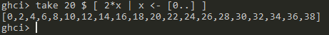
List comprehensions
Syntax for creating lists based on other lists
Takes the form : [output expression | variable <- input set , (predicate)

Slide 43
Tuples
Fixed length “list” of elements
E.g. (‘a’, 2) – tuples are like data mushed together into an unnamed record
They can be of any length
Their elements can be any data types
() , (1), (1,3), ([1,2,3], “banana”, True) are all examples of valid tuples
A pair of common function on a tuples is the fst and snd functions (which return the first and second elements of a tuple respectively. )
But deconstructing tuples is far more common - example
Notes:
let (height,weight,iq) = (135,145,101)
let (height,_,iq) = (135,145,101)

Slide 44
Code
examples
Notes:
https://docs.haskellstack.org/en/stable/README/

Slide 45
What’s Next?

Slide 46
Tools
Stack https://docs.haskellstack.org
Cabal (Common Architecture for Building Applications and Libraries )
Hspec
Hackage https://hackage.haskell.org/ Hackage
Hoogle https://www.haskell.org/hoogle/
vscode
Notes:
Stack is a scaffolding program for working with Haskell projects
Cabal is a system for building and packaging Haskell programs and libraries
Hspec – A testing framework for Haskell
Hackage is the Haskell community's central package archive
Hoogle is a Haskell API search engine,

Slide 47
Help and Practice
http://learnyouahaskell.com/chapters
https://functionalprogramming.slack.com
https://www.codewars.com
Go code some Haskell and make yourself a better developer

Slide 48
Functional Programming with Haskell
Quinn Wilson / qwilson@obsglobal.com / @quinnwilson

